Slide 1
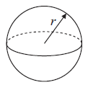
Literacy
Research
Memory
Volume
Sphere
Hemisphere
Radius
Find the radius of the Earth and show how you can work out its volume.
Volume = $\frac{4}{3}πr^{2}$
Skills
Stretch
Calculate the volume of these shapes to 2 decimal places.
1
2
3
4
1
5
6
7
8
2
9
10
11
12

