Slide 1
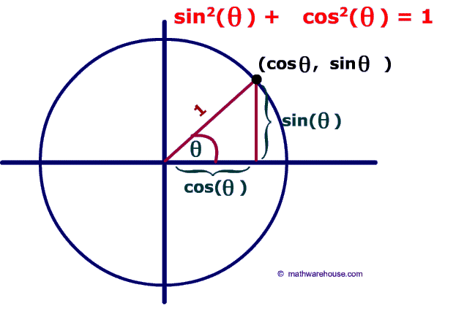

Research
Find out when trigonometry (sine, cosine and tangent ratios) were first discovered.
Memory
$$\sin^{2}θ+\cos^{2}θ≡1$$
$$tanθ≡\frac{sinθ}{cosθ}$$
C2 Trigonometric identities and simple equations
SKILL 1
2
Make sure you understand literacy, complete skill and memorise memory. Research and stretch and challenge are optional…
Literacy
Sine, cosine, tangent, unit circle, identity.
STRETCH AND CHALLENGE

Slide 2
SKILL

Slide 3
STRETCH AND CHALLENGE
http://www.examsolutions.net/a-level-maths-papers/worked-solution/worked-solution.php?paper_id=2001&solution=4.1

