Slide 1
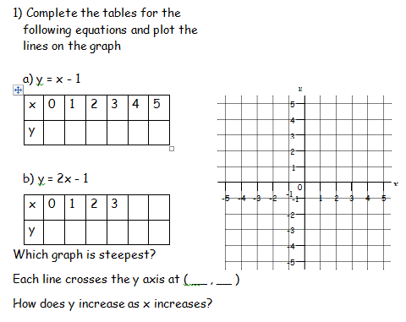
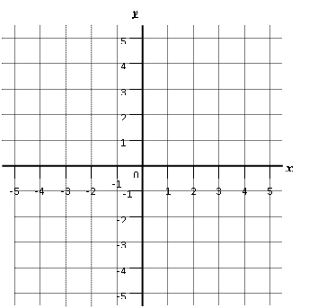
Literacy
Research
Memory
Equation
Gradient
Intercept
Find out the definitions of each of the words from the Literacy section
Produce a revision tool on how to draw a straight line graph
Skill Practice
Stretch!
a
b
Write down the equations of
The lines a and b

