Slide 1
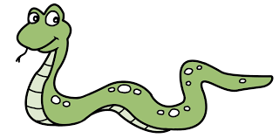

Starting off with Algebra
Literacy
Skills Practice
Can you unscramble theses sets of letters?
Describe the words you unscramble!
There are $s$ snakes in a bag. How many snakes are there if:
I add four?
I get a second bag of $s$ snakes?
I sell two snakes?
A pencil costs $x$ pence and a pen costs $y$ pence. What is the cost of:
Three pencils?
Twenty pencils?
A pencil and a pen?
Three pens and two pencils?
Terry has 4 pounds (£4). Tim has $P$ pounds and Tom has twice as much as Tim. How much money do:
Terry and Tim have?
Tim and Tom have?
Terry and Tom have?
Terry, Tim and Tom have?
F
M
L
S
P
Y
I
I
E
M
S
T
R
Research
Research the mathematician Mohammed ibn-Musa al-Khwarizmi and write about his contributions to algebra.
When did algebra first come into use?
Memory
Stretch
Don’t forget, in algebra a letter is representing an unknown number!!
It could be anything!
A father’s age is $x$ years, his son’s age is $y$ years and his daughter is four years old.
The father is four times older than the son.
Given that the son is three times older than his sister, find out the age of the father.

