Slide 1


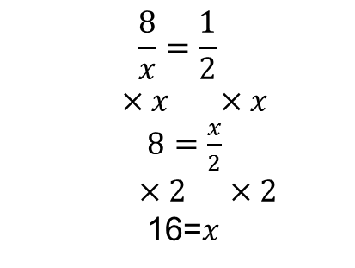
Literacy
Research
Support
Equation
Variable
Solve
inverse
Corbett Maths videos 111 & 112
Find 2 formulas that include a fraction with a variable in the denominator
Memory
$$\frac{8}{x}=\frac{1}{2}$$
$×x ×x$
$8=\frac{x}{2}$
$×2 ×2$
16=$x$
Skill Practice
Solve the following:
$\frac{40}{x}=10$
$\frac{15}{x}=3$
$\frac{−18}{x}=−3$
$\frac{20}{2x}=10$
2) Solve the following:
$\frac{6}{x}=18$
$\frac{28}{2x}=4$
$\frac{45}{4x}=$4.5
$\frac{31}{2x}=4$
Whatever you do to one side of an equation you must do to the other
Stretch
3) Solve the following:
$\frac{24}{x+3}=8$ b) $\frac{40}{x −3}=5 c) \frac{56}{10 −x}=8$
d) $\frac{13}{x+3}=2$ e) $\frac{2x}{x −3}=5$ f) $\frac{x −2}{x −8}=13$
$$x is a number. The ratio$$
$$4x:x+2=3:1$$
Explain why $\frac{4x}{x+2}=3$
Solve the equation to find the value of $x$

