Slide 1
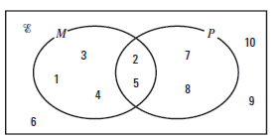

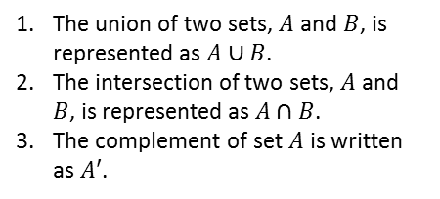
Sets and Venn diagrams
Literacy
Skills Practice
Write out a sentence explaining each of the following:
What a Venn diagram represents;
What the union of two sets means;
What the intersection of two sets means;
What the complement of two sets means.
Represent the following groups of sets on a Venn diagram:
$ε=\left\{1, 2, 3, 4, 5, 6\right\}$
$$A=\left\{1, 2, 6\right\}$$
$$B=\left\{2, 4, 6\right\}$$
$ε=\left\{1, 2, 3, 4, 5, 6\right\}$
$$A=\left\{2, 3, 5\right\}$$
$$B=\left\{2, 5\right\}$$
$ε=\left\{1, 2, 3, 4, 5, 6\right\}$
$$A=\left\{1, 2, 4\right\}$$
$$B=\left\{3, 6\right\}$$
For each part of question write down the members of the following sets:
$A∩B$
$A∪B$
$A′$
There are 60 people at an activity centre.
31 go sailing,
24 go sailing and go on the climbing wall,
12 do neither activity.
How many just go on the climbing wall but do not go sailing?
Research
Research who conceived the Venn diagram and when.
Try to find out some applications of Venn diagrams (maybe to real life!).
Write down the members of :
i) $P$ ii) $P∩M$ iii) $P∪M$
Memory
Stretch
The union of two sets, $A$ and $B$, is represented as $A∪B$.
The intersection of two sets, $A$ and $B$, is represented as $A∩B$.
The complement of set $A$ is written as $A′$.
Draw a Venn diagram if you need it!

