Slide 1
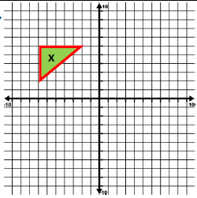
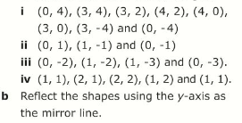
Literacy
Research
Memory
In a triangle ABC, what affect does reflecting the shape have on the lines AB, BC, AC or the angles A,B,C in the image?
Reflections require a mirror line, the image is always 90º to the mirror line.
Rotations always have 3 instructions, the centre of the turn, the amount of turn and the direction of turn.
What do the key words below mean?
Object, image, congruent, reflection, rotation
Skill Practice
Stretch
Using a co-ordinate grid from 4 to -4 for both x and y axis, plot and join up the following
(-2,6)
(-7,6)
(-7,2)
Reflect X in the line y = x
c) Rotate this shape X 90º clockwise about the origin Label it Y
d) Reflect Y in the x axis and label the new shape Z
Homework effort
10

