Slide 1
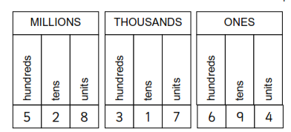
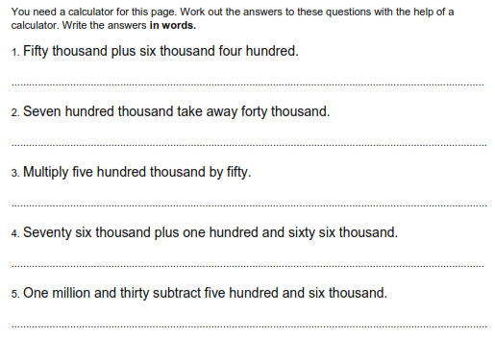
Literacy
Research
Memory
Place value, digit, integer, units, tens, hundreds, thousands, millions
Use the website to find out your age in seconds http://www.mathcats.com/explore/age/calculator.html!
Skill Practice
Stretch!

