Slide 1
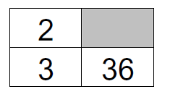
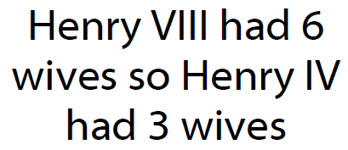
Title: Ratio
Set on: 6th December
Due on: Friday 9th December
d
Use the ratio
box to show
the ratios. Look for links
vertical or
horizontal
Literacy
Research
Memory
Fraction
Parts
Ratio
Proportion
Estimate what proportion
of the year you spend in
school.
x12
Skill
You and a friend buy a £5
scratch card, you hand over £3 and your friend £2. You win £2000 how much
money should you each get?
Fill in the missing numbers
Challenge
What is wrong with this
statement?

Slide 2
Title: Ratio
Set on: 6th December
Due on: Friday 9th December
d
Use the ratio
box to show
the ratios. Look for links
vertical or
horizontal
Literacy
Research
Memory
Fraction
Parts
Ratio
Proportion
Estimate what proportion
of the year you spend in
school.
x12
Skill
You and a friend buy a £5
scratch card, you hand over £3 and your friend £2. You win £2000 how much
money should you each get?
Fill in the missing numbers
Challenge
What is wrong with this
statement?

