Slide 1
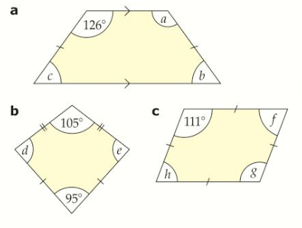
Literacy
Research
Memory
Learn the following spellings:
Quadrilateral, Trapezium, Parallelogram, Deltoid, Rhombus, Rectangle, Square, Irregular
Find some examples of where you might find quadrilaterals in real life
Interior angles of a quadrilateral add up to 360º
Skill Practice
Stretch!
List all of the quadrilaterals which have:
Four right angles
Four equal sides
One pair of parallel sides
Two pairs of equal angles
For each quadrilateral below, name the shape and calculate the size of the missing angles.

