Slide 1
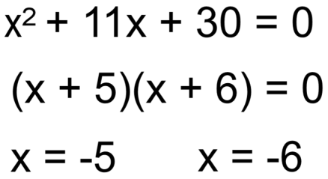
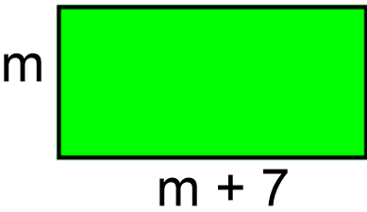
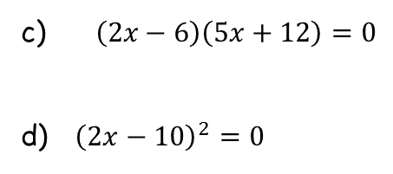


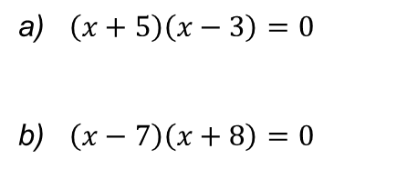
Literacy
Research
Memory
Define each of these:
What is the quadratic formula?
What is it used for?
Communication is the most important part! Solving equations should look like this:
Quadratic equation
Expanded form
Factorised form
Skill Practice
You may want to draw a grid to help your working out
1) Solve following equations.
Stretch!
$\left(x+5\right)\left(x−3\right)=0$
$\left(x−7\right)\left(x+8\right)=0$
$\left(2x−6\right)\left(5x+12\right)=0$
${\left(2x−10\right)}^{2}=0$
The area of the shape below is 60cm²
Write down an equation.
Solve your equation to work out the value of m.
2) Solve these equations, showing each step clearly.
$x^{2}+2x+1=0$
$x^{2}+8x+12=0$
$x^{2}−2x−35=0$
$x^{2}−14x+24=0$
3) Solve these equations, showing each step clearly.
$x^{2}−6x=8$
$x^{2}=10x−21$

