Slide 1
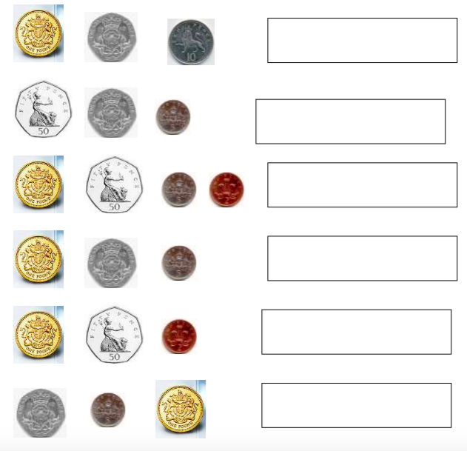
Stretch
Book £2.99
Chocolate 50p
Pen £1.30
Literacy
Homework
If I buy the following items from my list. How much do they cost altogether?
How much change do I get from £5?
Number
Circle the words that mean add
Multiply
Plus
Sum
Share
Addition
Total
Take
Skill
Practice
Times
Altogether
Write down the amounts shown on the left in the boxes.
Don’t forget the pence ‘p’ or pound ‘£’ sign
Assessed
WWW
………………………………
…………………………………
EBI
……………………………….
………………………………..

