Slide 1
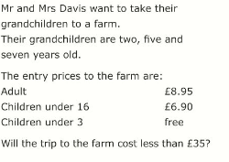
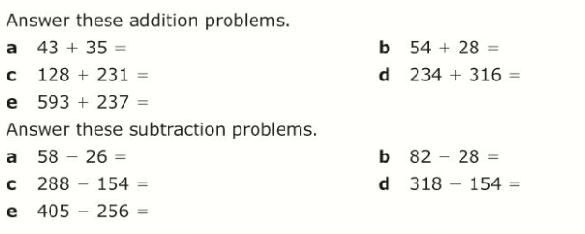
Literacy
Research
Memory
Addition
Subtraction
Multiplication
Division
Find out the definitions of each of the words from the Literacy section
Practise your
7 and 8 times tables
ready for a test
Skill Practice
Stretch!
Mental Calculations

