Slide 1
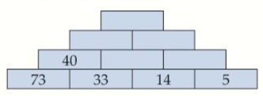
Literacy
Research
Memory
add addition subtract subtraction less than more than
Find other words that mean add and subtract
Learn the number bonds of 10
Skill Practice
Stretch!
Use the method of ‘adding tens then units’ to find each answer.
54 + 31 b) 70 + 14 c) 62 + 22 d) 79 + 12
2) Use a number line to find the answer if you need to.
77 + 35 b) 88 + 26 c) 60 + 54 d) 83 + 28
3) Use the method ‘ subtract tens then units’ to the find the answer
89 - 43 b) 68 – 22 c) 96 – 51 d) 81 – 39
4) Find the answers. Use a number line if you need to.
a) 102 – 57 b) 110 – 65 c) 91 – 48 d) 102 - 43
In this pyramid, each number is found by adding the two numbers below it.
In this pyramid, each number is found by subtracting the two numbers below it.

