Slide 1
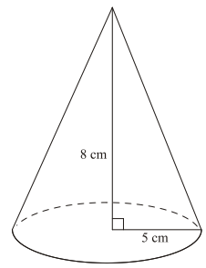
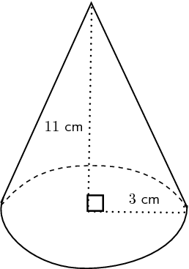
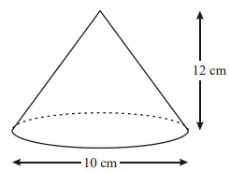
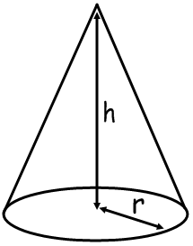
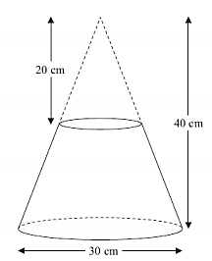
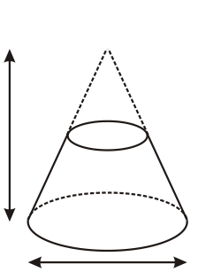
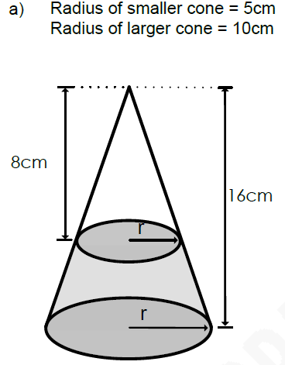
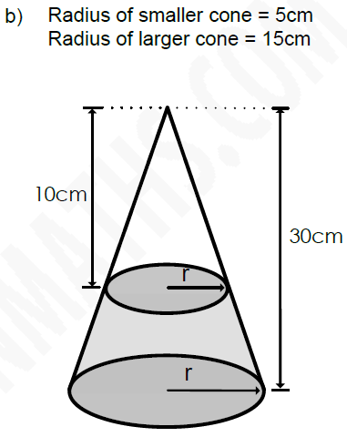
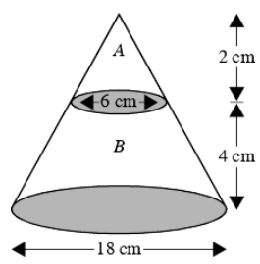
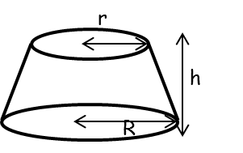

Memory
ROK
Find the volume of these cones to 3 s.f.
Frustums
$$V=\frac{1}{3}πr^{2}h$$
1.
2.
3.
Use similar shapes to find the missing dimensions. Then calculate the volume of the frustums.
Stretch 1
11.3 cm
10cm
5.7 cm
r
h₂
h₁
Find the volume of the frustums
4cm
5cm
Stretch 2
Use the dimensions to calculate the height of the bigger cone, and calculate the volume of the frustums.
Skill 1
3m
r
2cm
Skill 2
Find the volume of these frustums
10m
h
9m
3cm
4cm
R
Write a formula for the volume of a frustum using just these dimensions.
$$V=$$
40mm
h
12cm

Slide 2

Memory
ROK
Find the volume of these cones
ANSWERS
$$V=\frac{1}{3}πr^{2}h$$
1.
2.
3.
Use similar shapes to find the missing dimensions. Then calculate the volume of the frustums.
$$\frac{1}{3}×π×5^{2}×8=209 cm^{3}$$
$$\frac{1}{3}×π×{5.7}^{2}×11.3=384 cm^{3}$$
Stretch 1
11.3 cm
10cm
5.7 cm
$$\frac{1}{3}×π×{\left(\frac{10}{2}\right)}^{2}×12=314 cm^{3}$$
r
15cm
h₂
4cm
h₁
8cm
Find the volume of the frustums
$$1676−209=1467cm^{3}$$
$$7069−262=6807cm^{3}$$
5cm
4cm
$$509−19=690cm^{3}$$
Use the dimensions to calculate the height of the bigger cone, and calculate the volume of the frustums.
Stretch 2
Skill 1
3m
r
2cm
Skill 2
Find the volume of these frustums
h = 5cm
V = 1225cm³
10m
h
9m
h = 6cm
V = 88cm³
3cm
4cm
R
Write a formula for the volume of a frustum using just these dimensions.
$$553m^{3}$$
$$1152m^{3}$$
$$660m^{3}$$
$$788m^{3}$$
$$V=$$
$$\frac{1}{3}πh(R^{2}+rR+r^{2})$$
40mm
h
12cm

