Slide 1
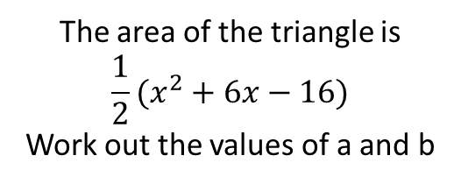

Literacy
Research
Memory
Expand
Factor
Quadratic
Sum
Product
Coefficient
What is the quadratic formula and what is it used for?
$$x^{2}+bx+c$$
You are looking for factors of c that add to make b
Skills
Stretch
Factorise:
$x^{2}+7x+10$
$x^{2}+5x+4$
$x^{2}+7x+12$
$x^{2}−7x+12$
$x^{2}+6x+8$
$x^{2}+2x−8$
$x^{2}−2x−8$
$x^{2}−6x+8$
$x^{2}+15x+36$
$x^{2}−8x+16$
The area of the rectangle is
$$x^{2}+14x+24$$
Work out the values of a and b
$$(x+b)$$
$$(x+a)$$
The area of the triangle is
$$\frac{1}{2}(x^{2}+6x−16)$$
Work out the values of a and b
$$(x+b)$$
$$(x−a)$$

