Slide 1
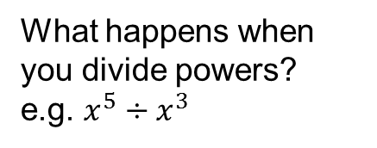
Literacy
Research
Memory
Factorise
Expand
Variable
Expression
What happens when you divide powers?
e.g. $x^{5}÷x^{3}$
a x a = a²
a + a = 2a
Factorise means to put back into brackets
Expanding brackets means to multiply
Skill Practice
Expand the following:
3t(r + t)
7y(2p + y)
5e(4e – 1)
9p(2r – 5p)
11d(-2d – 3f)
2) Factorise the following as much as possible:
xy + x
rt – t
5jk + k²
8ab + 4b²
21pq + 14p²q
Stretch
Expand the brackets and simplify as far as possible:
2a(a + b) + 3a(a + 2b)
4c(2c + d) + 5c(3c – d)
3e(2e – f) + 4e(6e – 2f)
5g(g + h) – 2g(g + 2h)
6j(2j + k) – 4j(3j + k)
7m(2m – n) – 3m(5m – n)
3) Simplify the following expressions:
4ab + 5a² - 3ab + 2a²
6d² - 2de – 3d² + 4de
12g² - 3fg + 6g² + 5gf
8hj – 2h² - 3jh – 5h²
-10m² - 3ml + 7lm + 3m²

