Slide 1
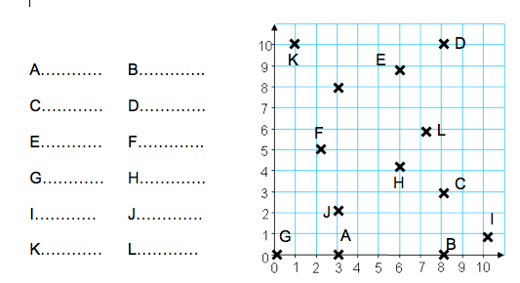
Skill 1
Literacy
Memory
Plot these:
A: (4,9)
C: (7,9)
E: (9,6)
G: (9,3)
What shape is this?
(x, y)
“Along the corridor and up the stairs”
B: (7,0)
D: (4,0)
F: (2,3)
H: (2,6)
These words have been jumbled. Work out what they are:
nCiroa-odet
sixA
lotP
zrnaHoolit
laicrteV
Skill 2
Read the following co-ordinates and write them in the spaces below. Make sure you use brackets EG: (3, 5)
Co-ordinates
Plot and label two co-ordinates that would make this into a rectangle.
Stretch
(9,8)
(2,3)

Slide 2
Skill 1
Literacy
Memory
Plot these:
A: (4,9)
C: (7,9)
E: (9,6)
G: (9,3)
What shape is this?
(x, y)
“Along the corridor and up the stairs”
B: (7,0)
D: (4,0)
F: (2,3)
H: (2,6)
These words have been jumbled. Work out what they are:
Co-ordinate
Axis
Plot
Horizontal
Vertical
Octagon
Skill 2
Read the following co-ordinates and write them in the spaces below. Make sure you use brackets EG: (3, 5)
ANSWERS
(3,0)
(8,3)
(6,9)
(0,0)
(10,1)
(1,10)
(8,0)
(8,10)
(2,5)
(6,4)
(3,2)
(7,6)
Plot and label two co-ordinates that would make this into a rectangle.
Stretch
(2,8)
(9,8)
(2,3)
(9,3)

