Slide 1
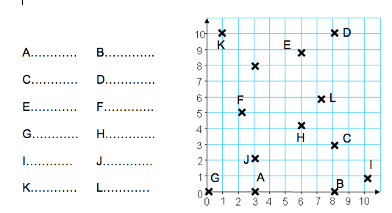
Stretch
Literacy
Homework
Plot:
(0, 1), (9, 1), (9, 4)
Which co-ordinate would complete the rectangle? ……
Co-ordinates
Write out the following words:
Coordinate
……………………….
Axis
……………
Quadrant
………………………..
Skill Practice
Read the following co-ordinates and write them in the spaces below. Make sure you use brackets EG: (3, 5)
Assessed
WWW
………………………………
…………………………………
EBI
……………………………….
………………………………..

