Slide 1
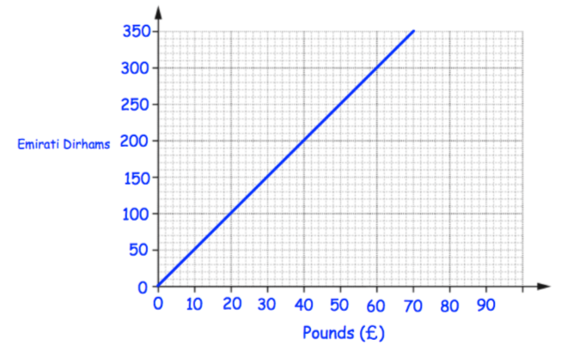
Literacy
Research
Memory
Fixed rate
Gradient
Origin
Conversion
Research the use of conversion graphs in currency exchange.
Remember to label the axes and include units of measurement on all graphs.
Always use a ruler and a pencil to draw a graph.
Skill Practice
Stretch!
5 miles = 8 kilometres
Use the information above to draw a conversion graph for miles to kilometres.
How far is 7 miles in kilometres?
How far is 10 kilometres in miles?
A car travels 200 miles. What is this in kilometres?
How far is 3200m in miles?
Use the graph to convert the following:
£50 into Dirhams
175 Dirhams into Pounds
Tom wants to buy a camera. ! In London the camera costs £380. In Abu Dhabi the camera costs 2000 Dirhams. In which city is the camera cheaper and by how much? Give your answer in pounds.

