Slide 1
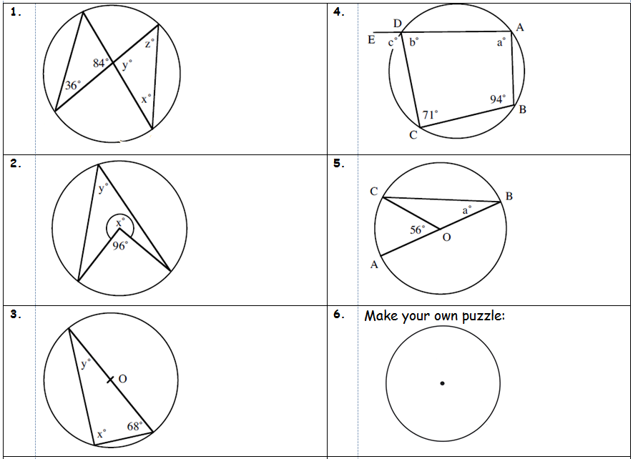
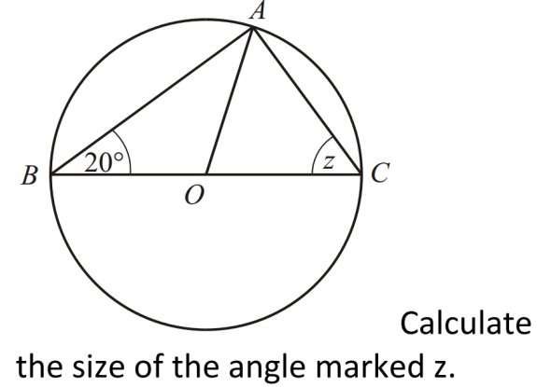
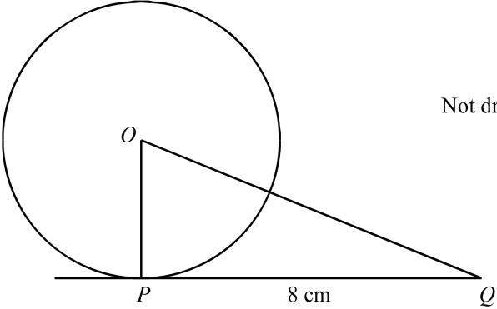
Literacy
Research
Memory
Write a definition:
Sector
Segment
Cyclic Quadrilateral
What is the alternate segment theorem?
Explain your two favourite circle theorems to a member of your family/friend.
Draw a diagram to explain.
Skill Practice
Find the missing angles
Stretch!
The area of the triangle is 24cm².
Find the area of the circle

