Slide 1
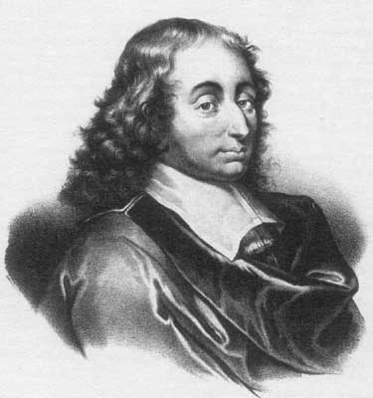
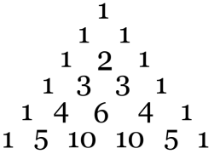
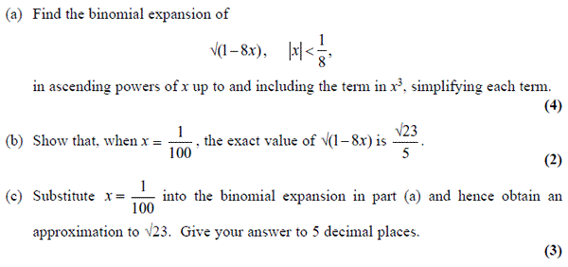
Literacy
Explain the condition when there would be a finite number of terms. Why is this?
Research
Where did the factorial sign come from and when was it first used?
Memory
The Binomial Expansion
SKILL
STRETCH AND CHALLENGE

Slide 2
SKILL

Slide 3
STRETCH AND CHALLENGE

