Slide 1
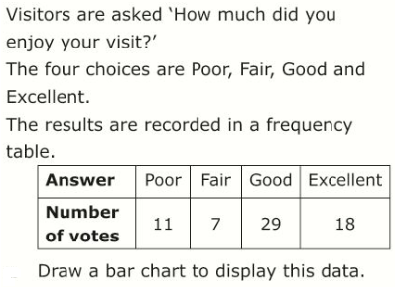
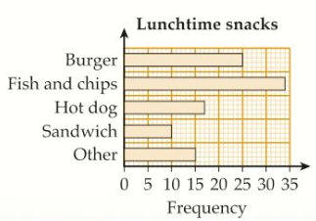
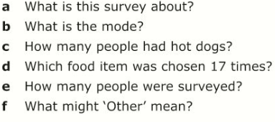
Literacy
Research
Memory
Frequency Table
Bar Chart
Axes
Comparative
Discrete
Find a piece of data in a newspaper, magazine or on the internet, which is displayed in a bar chart
When drawing bar charts:
All bars must be of equal width
Bars must have equal spaces between them
Skill Practice
Stretch!

