Slide 1
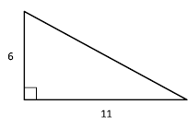
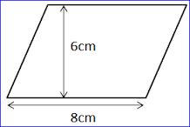
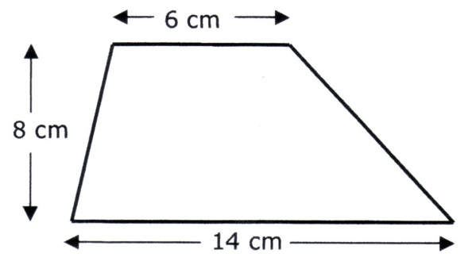
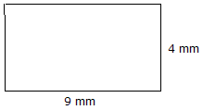
Homework
Memory
Literacy
Find three Maths words in the wordsearch below
Area
Learn the following rules:
Area of Triangle: Base x Height
2
Area of parallelogram: Base x perp. Height
Area of a trapezium: ½ (a + b) x h
A | D | D | S | S
R | P | R | E | H
E | L | B | M | A
A | U | O | I | P
C | S | A | T | E
Stretch
Draw a trapezium with an area of 12cm² Not to scale but write measurements
Draw a triangle with an area of 12cm². Not to scale
Skill Practice
Find the area of the shapes below
1.) ………………………..
2.) ………………………..
3.) ………………………….
Assessed
WWW
………………………………
…………………………………
EBI
……………………………….
………………………………..

