Slide 1
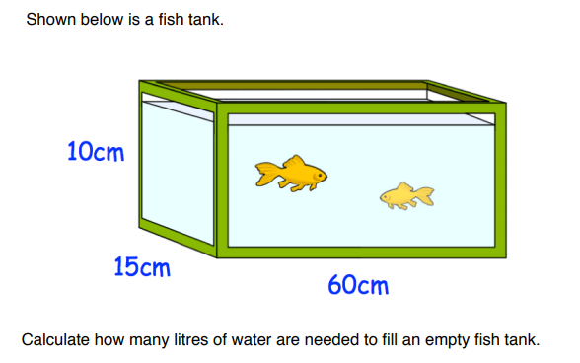
Literacy
Research
Memory
Length
Capacity
Weight
Mass
What is the difference between a metric tonne and an imperial ton?
Draw a basic square to help for area conversions.
Draw a basic cube to help for volume conversions.
Skill
Challenge
Convert the following:
8cm² into mm²
7.2m² into cm²
30 000cm² into m²
650mm² into cm²
4cm³ into mm³
5 000mm³ into cm³
9 000 000cm³ into mm³
3.4cm³ into mm³
4m³ into litres

