Slide 1
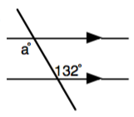
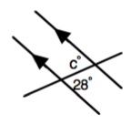
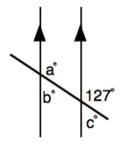
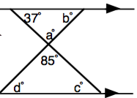
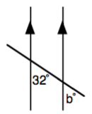
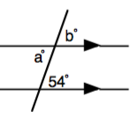
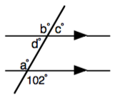
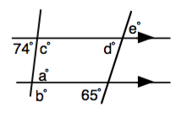
Angles in Parallel Lines
Literacy
Memory
Copy and complete these sentences:
Alternate angles are ___________.
Angles around a ______________ sum to 360°.
Co-interior angles sum to ______°.
Look up the word transversal and write a definition that you understand.
Draw diagrams for the following. Label them and write the angle fact next to your diagram.
Corresponding angles Adjacent angles
Vertically opposite angles Co-interior angles
Supplementary angles Complementary angles
Skills Practice
Research
Find the missing angles and state the angle fact you used to find it.
If there is more than one angle to be found in the questions, find them in alphabetical order.
Find and explain a proof that the interior angles of a triangle sum to 180° using angles in parallel lines.
1
3
5
Stretch
Complete as with the skills practice
7
2
4
6
8

