Slide 1
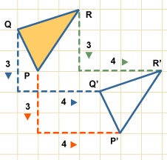
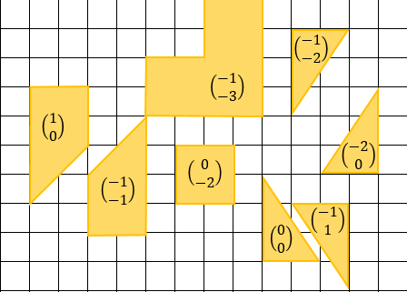
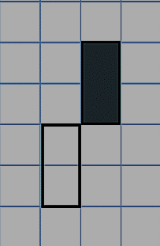
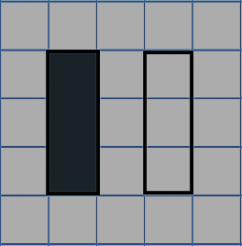
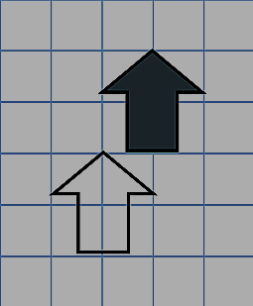
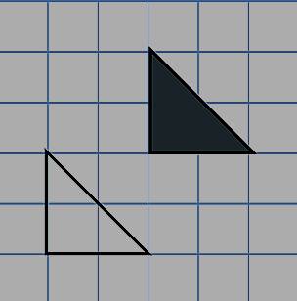
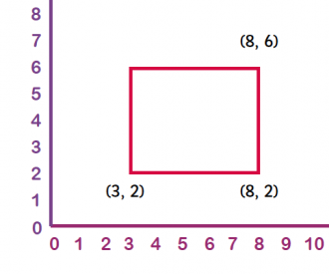
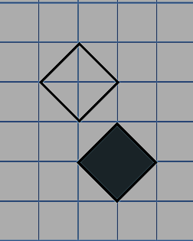
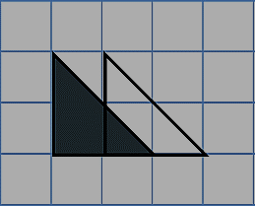



Translations
Memory
The Hungry Caterpillar has eaten the vowels from these words! Save the day and fill them back in.
The top number in a vector tells you how many squares right to go, and the bottom number tells you how many up. If it’s negative, go the opposite way!
Literacy
H_r_z_nt_l
V_rt_c_l
_r_g_n
V_ct_r
C_-_rd_n_t_s
$$\left(\begin{matrix}4 \\ −3\end{matrix}\right)$$
Skill 1
Skill 2
For each pair of shapes, describe the translation from the shaded shape to the non-shaded shape.
Translate the shape by the given vectors and label them with the correct letter.
Stretch 1
Translate each shape by the vector inside it. What does it spell out?
Stretch 2
Work out the missing co-ordinate and translate this shape by the vector $\left(\begin{matrix}2 \\ −1\end{matrix}\right)$. What are the new coordinates?
A: $\left(\begin{matrix}9 \\ 2\end{matrix}\right)$
D: $\left(\begin{matrix}−3 \\ 5\end{matrix}\right)$
B: $\left(\begin{matrix}3 \\ 0\end{matrix}\right)$
E: $\left(\begin{matrix}−7 \\ −3\end{matrix}\right)$
C: $\left(\begin{matrix}4 \\ −6\end{matrix}\right)$
F: $\left(\begin{matrix}−8 \\ −10\end{matrix}\right)$

Slide 2
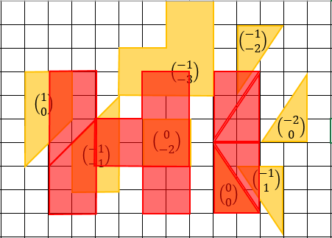
Translations - ANSWERS
Memory
The Hungry Caterpillar has eaten the vowels from these words! Save the day and fill them back in.
The top number in a vector tells you how many squares right to go, and the bottom number tells you how many up. If it’s negative, go the opposite way!
Literacy
Horizontal
Vertical
Origin
Vector
Co-ordinates
$$\left(\begin{matrix}4 \\ −3\end{matrix}\right)$$
Skill 1
Skill 2
For each pair of shapes, describe the translation from the shaded shape to the non-shaded shape.
Translate the shape by the given vectors and label them with the correct letter.
Stretch 1
D
$$\left(\begin{matrix}2 \\ 0\end{matrix}\right)$$
A
B
$$\left(\begin{matrix}1 \\ 2\end{matrix}\right)$$
E
C
Translate each shape by the vector inside it. What does it spell out?
$$\left(\begin{matrix}−1 \\ −2\end{matrix}\right)$$
F
$$\left(\begin{matrix}2 \\ −2\end{matrix}\right)$$
Stretch 2
Work out the missing co-ordinate and translate this shape by the vector $\left(\begin{matrix}2 \\ −1\end{matrix}\right)$. What are the new coordinates?
(3,6)
$$\left(\begin{matrix}−1 \\ 2\end{matrix}\right)$$
(10,5)
$$\left(\begin{matrix}1 \\ 0\end{matrix}\right)$$
A: $\left(\begin{matrix}9 \\ 2\end{matrix}\right)$
D: $\left(\begin{matrix}−3 \\ 5\end{matrix}\right)$
B: $\left(\begin{matrix}3 \\ 0\end{matrix}\right)$
E: $\left(\begin{matrix}−7 \\ −3\end{matrix}\right)$
C: $\left(\begin{matrix}4 \\ −6\end{matrix}\right)$
F: $\left(\begin{matrix}−8 \\ −10\end{matrix}\right)$
(5,5)
(5,1)
(10,1)

