Slide 1
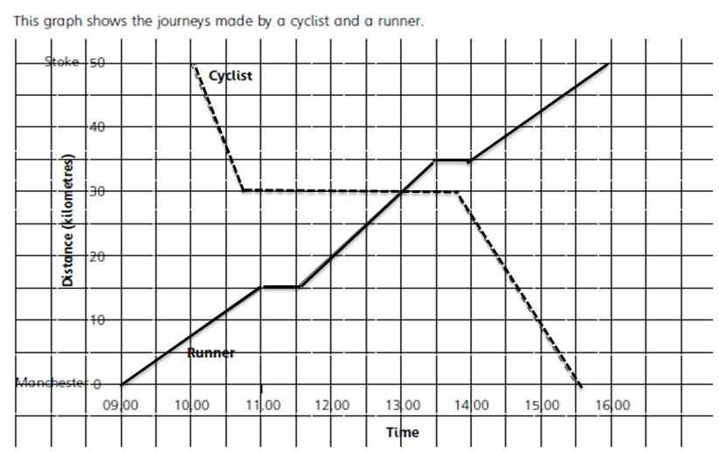
Literacy
Research
Memory
Average Speed Distance
Time
What are the units used to measure speed?
Memorise the formula
Speed = Distance
Time
Skill Practice
1.a) What time did the runner and cyclist meet?
b) how far were they from Stoke?
2. How many times did the runner stop?
3. What time did the cyclist start his journey?
Stretch!
Draw a time distance graph of your own and tell the story of the journey.
4. a) Between which times did the runner travel fastest?
b) How did you decide?
5. How long did the cyclist stop during his journey?
6. Where did the cyclist finish his journey?
7. How far is it from Stoke to Manchester?
8. What was the speed of the runner at: a) 10:00 b) 12:00 ?
What was the speed of the cyclist at: a) 10:30 b) 14:30

