Slide 1
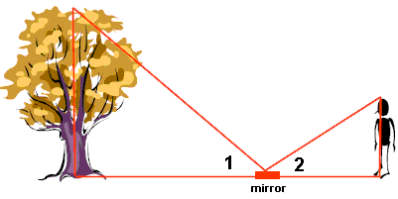
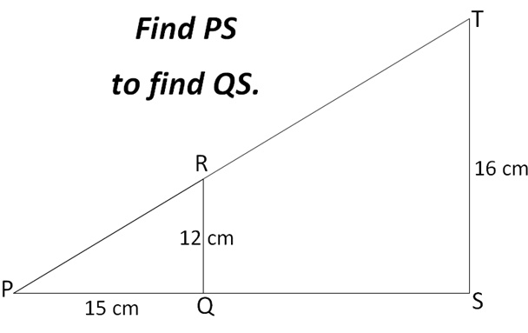
Literacy
Write a definition for each of the following words:
Scale Factor
Corresponding
Ratio
Similar
Research
A triangle has height 6cm and base 3cm. If it is enlarged so that each length is doubled (scale factor 2), how much bigger is the area of the new shape?
Memory
Remember to look for corresponding sides as you need to calculate the scale factor in order to find missing lengths
SIMILAR TRIANGLES
SKILL
STRETCH AND CHALLENGE

