Slide 1
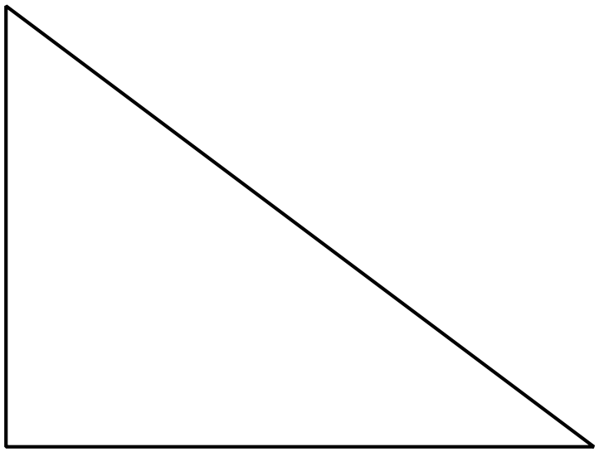
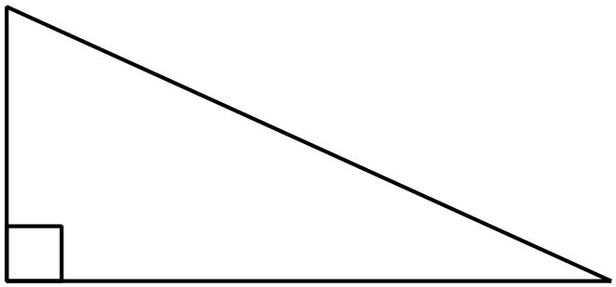
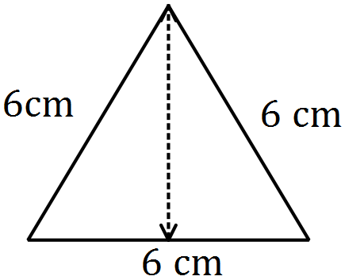
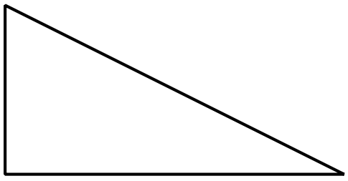
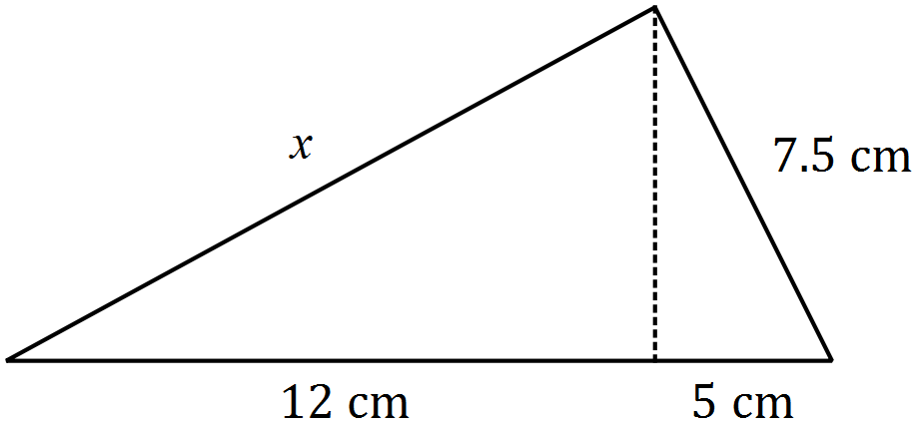
Key words: Right-angled, triangle, hypotenuse, square, root
Mathswatch Clip 150a
Corbett maths Video 257
Write a step by step guide showing how we use Pythagoras’ Theorem.
Challenge: Use no more than 50 words.
Find three examples of Pythagorean Triples.
Long Side: Square and Add
Short Side: Square and Subtract
Pythagoras Homework
Find the values of $x$ for the following triangles
(2 d.p.)
$$5$$
$$11$$
$$x$$
$$9$$
1. Find the vertical height of this triangle
$$x$$
$$12$$
2. Is this triangle right-angled?
$$x$$
$$8$$
$$4$$
2. Find the value of $x$
$$26$$
$$24$$
$$10$$

Slide 2
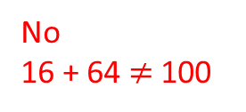
Key words: Right-angled, triangle, hypotenuse, square, root
Mathswatch Clip 150a
Corbett maths Video 257
Write a step by step guide showing how we use Pythagoras’ Theorem.
Challenge: Use no more than 50 words.
Find three examples of Pythagorean Triples.
Long Side: Square and Add
Short Side: Square and Subtract
Pythagoras Homework
Find the values of $x$ for the following triangles
(2 d.p.)
$$5$$
$$11$$
$$15$$
$$9$$
1. Find the vertical height of this triangle
$$12.08$$
5.20 cm
$$12$$
2. Is this triangle right-angled?
$$10$$
$$8$$
$$4$$
2. Find the value of $x$
$$26$$
No
16 + 64 $≠$ 100
13.24 cm
$$24$$
$$10$$

